Slide 1
Logistic Regression

Slide 2
Contents
Logistic Regression
How it works
Model Evaluation Parameters

Slide 3
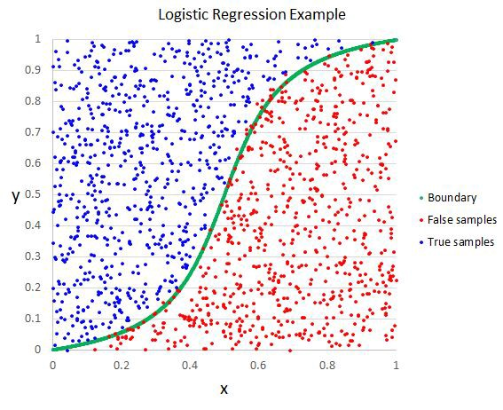
Logistic Regression
Supervised | Regression | Classification
 | x
Logistic regression is a special case of linear regression where logit function restricts the output between 0 and 1

Slide 4
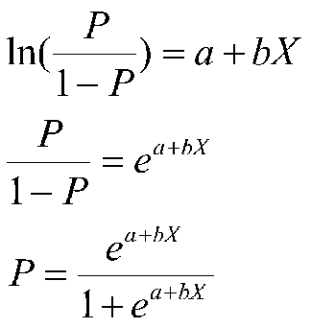
Logistic Regression
Logit is a log of odds and odds are a function of P, the probability of a 1. In logistic regression, we find
logit(P) = a + bX,

Slide 5
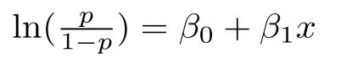
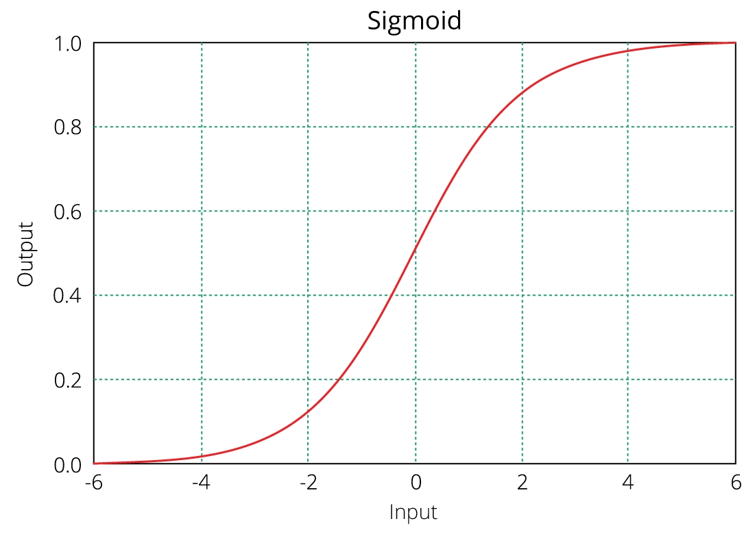
Equation of logistic regression
log - odds or odds ratio or logit function and is the link function for
Regression intercept & coefficient
This link function follows a sigmoid function which limits its range of probabilities between 0 and 1.

Slide 6
Confusion Matrix
 |  | Predicted
 |  | 0 | 1
Observed | 0 | TN | FP
 | 1 | FN | TP
$$Specificity=\frac{TN}{TN+FP}$$
$$Precision=\frac{TP}{TP+FP}$$
$$Recall or Sensitivity=\frac{TP}{TP+FN}$$

Slide 7
F1 Score
A single metric is not sufficient for the evaluation of classification models. We have seen that we need to use recall and precision together along with accuracy to evaluate our model.
Let us consider another metric that puts together the recall and precision metrics. We call it F1 Score.
F1 Score = 2(precision*recall)/precision + recall
-which is the harmonic mean of the two metrics.
The F1 score can also be used to evaluate the model.

Slide 8
ROC and Gini Coefficient and Threshold
Roc is a curve which allows us to compare models.
It is plot between TPR(true positive rates) and FPR(false positive ratio).
The area under the ROC curve (AUC) is a measure of the how good a model is.
Gini Coefficient:
It is also used to measure the goodness of a fit.
It is the ratio of areas in a roc curve and is scaled version of the AUC.
GI = 2*AUC -1

